Slide 1

COAL(COMPUTER ORGANIZATION AND ASSEMBLY LANGUAGE)PROJECT
MADE BY: Syed Ali Jodat ( 20K0155 )
Abdul Ahad Sheikh ( 20K0319 )

Slide 2
OBJECTIVE
Mainly the purpose of this project was to implement our understanding of assembly language. It could perform multiple scientific calculator's operation related to equations.
Such as, operations on Simultaneous linear equations and quadratic equations.

Slide 3
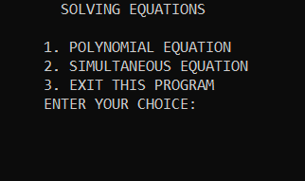
MAIN DISPLAY

Slide 4
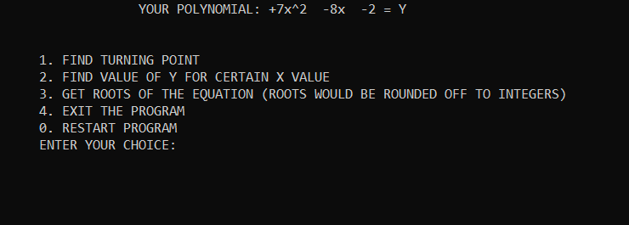
OPERATIONS
ON QUADRATIC EQUATION:

Slide 5
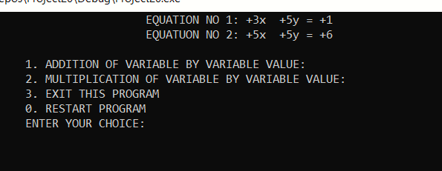
OPEARTIONS
ON SIMULTANEOUS EQUATION:

Slide 6
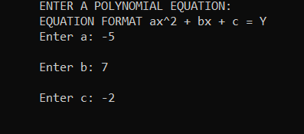
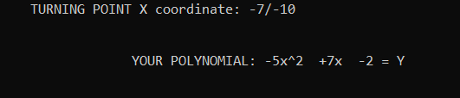
OPERATIONS ON QUADRATIC EQUATION
Entering Equation
Finding Turning point of an equation

Slide 7

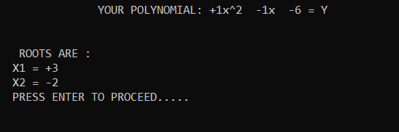
OPERATIONS ON QUADRATIC EQUATION
Finding value of Y for certain value of X
Finding Roots of Equation

Slide 8
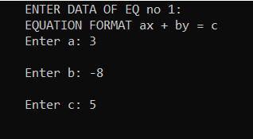
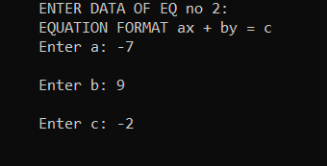
OPERATIONS ON SIMULTANEOUS EQUATION
Entering Equation

Slide 9
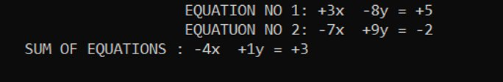

OPERATIONS ON SIMULTANEOUS EQUATION
Variable by variable addition
Multiplication of equation coefficients

